Slide 1
Key findings from policy development studies
Peter Berkowitz, DG REGIO
EGESIF meeting, 21 September 2016

Slide 2
11 Studies launched
1. Analyse 2014-2020 programming phase
4 studies ("new provisions", ex ante conditionalities, performance framework, partnership principle)
2. Assess the impacts and effects of the thresholds and limits introduced in the CPR
Study on "thresholds and limits" (setting up a database of 2007-2013 operations)
3. Analyse 2014-2020 programme implementation and options to feed into the impact assessment
6 studies (simplification, financial instruments, coordination and harmonisation, alternative delivery mechanisms, feasibility study on budget support, country specific recommendations )

Slide 3
Methodological approach
Desk studies of all PAs and ERDF/CF programmes, including cooperation and multi-fund programmes co-financed by the ESF
Web-based surveys to all Managing Authorities
Structured interviews of key actors at national/regional levels
Shared with MS: draft final reports of studies on performance framework, ex-ante conditionalities, "new provisions"
Presentation is highly synthetic – considerable diversity at MS level

Slide 4
Performance framework
Key findings (1)
Performance frameworks perceived as beneficial for a stronger result orientation and direction of programmes
The development of the performance frameworks has generated considerable debate and exchanges
Member States have made efforts to establish the performance framework on a solid basis
The choice of indicators for milestones and targets was in line with Commission guidance
Setting milestones and indicators was mainly a straightforward task
.
.

Slide 5
Performance framework
Key findings (2)
Strengths:
Better steering and guiding of programme implementation; more realistic definition of targets and expectations, increased focus
Need to establish a performance framework has triggered reflections and discussions on the setting of objectives, monitoring of progress and on the implementation of an increased focus on results within Member States and with the Commission
Weaknesses
Risk of conservative target setting
Balance between shorter-term output-based indicators, milestones etc. on the one hand, and the drive for long-term results, supported by evaluation and policy learning

Slide 6
Performance framework
What do you see as the main benefit of the performance framework?

Slide 7
Performance framework
Did you have particular difficulty with establishing a methodology and criteria to select indicators for the performance framework?

Slide 8
Ex-ante conditionalities
Key findings (1)
Ex-ante conditionalities (ExAC) have proved highly relevant for programming of ESI Funds;
A learning process for all stakeholders involved;
Very ambitious in terms of strategic reform for many Member States and for their cooperation with the EC;
The process was considered lengthy; at the same time more time would be needed in order to ensure higher quality deliverables;
Guidance material provided by the Commission was very much appreciated.

Slide 9
Ex-ante conditionalities
Key findings (2)
Strengths:
Process increased awareness in MS about the necessary pre-conditions for effective implementation of public investments and addressed shortcomings in these.
Increased cooperation between the national and regional level in the MS but also between the MS and the Commission.
Improvements in the investment framework already occurred during the programming process. A considerable amount of conditionalities were fulfilled between the adoption of the PA and the OPs.
Weaknesses:
Considerable resource implications; the effort for fulfilling ExAC was considered high and sometimes disproportionate by certain more developed MS.

Slide 10
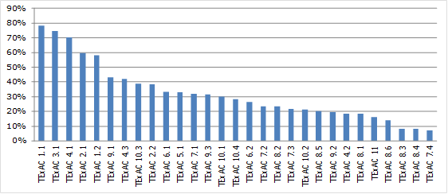
Ex-ante conditionalities
Frequency of the applicable thematic ex ante conditionalities in OPs

Slide 11
Partnership
Key findings (1)
Partnership improved in the 2014-2020 ESIF period as compared to previous programming periods.
The partnership principle is implemented very differently across the EU. Implementation depends on national administrative structures and cultures, technical and financial capacity of partners and political environment.
Positive contribution of The Code of Conduct - by clarifying the role of partnerships and the application of the partnership principle.
Working in partnership is generally perceived as a benefit.
Partnerships appear as generally balanced with some cases of discrepancy between the actual and the perceived representation of certain partner group (example: local authorities).

Slide 12
Partnership
Key findings (2)
Countries that joined in or after 2004 have more often established new partnerships compared to countries that joined before 2004.
A wide range of participation processes exists, depending on the target group (e.g. broad public consultations, targeted consultation, thematic seminars).
Almost all programmes have planned actions to involve partners during the implementation process (mainly through committees).
The informal dialogue with the Commission was perceived as more useful in the context of programmes rather than PAs.
Challenges do persist, the most important being the mobilisation of partners.

Slide 13
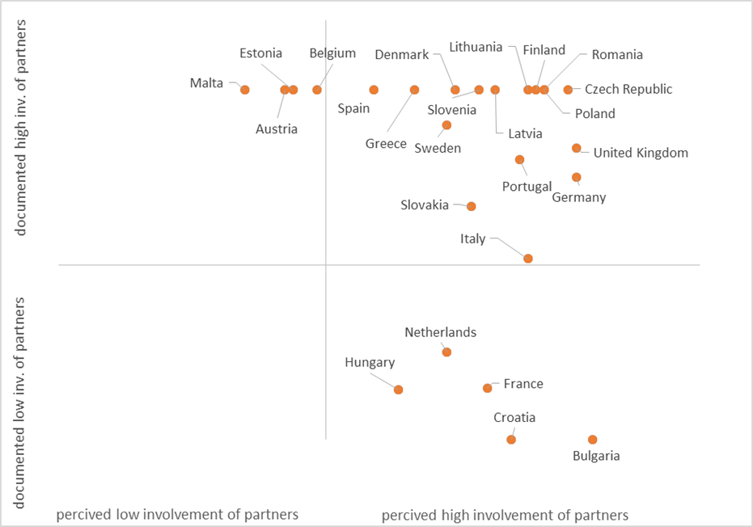
Partnership
Involvement of partners in the drafting process of programmes

Slide 14
New provisions
Key findings (1)
PA and OP have been substantially aligned with the priorities of the Europe 2020 strategy and CSRs. Explicit references in programmes representing 58% of Cohesion Policy budget.
Substantial degree of concentration of ERDF and the Cohesion Fund on key thematic objectives.
New provisions have altered the approach to programming, towards thinking in terms of a hierarchy of objectives and results. The identification of result indicators was difficult, but overall the objectives and results are found well defined.

Slide 15
New provisions
Key findings (2)
Over 40% of Cohesion Policy budget implemented through combined priority axes. May help to achieve synergies between programmes or regions, but also complicate programme structures. Justifications provided for the use of combined priority axes were often missing or poor.
Share of financial instruments is planned to increase in comparison to previous programming period, although new provisions on FI perceived as complex and received with caution.
New territorial instruments, especially ITI and SUD, considered as useful tools to address complex cross-sectorial challenges in a territorial context; uptake in OPs is good. MS cautious about the delegation of functions to sub-national actors.

Slide 16
New provisions
Key findings (3)
New provisions related to management (funds co-ordination, capacity building, reduction of administrative burdens, electronic administration) well received by the Member States and well complied with in the programming documents, which provides a good basis for developing implementation capacity.
In the programming process, the largest initial differences between the Commission and managing authorities concerned result indicators and specific objectives, the selection of actions to be supported and the use of combination axes.

Slide 17
New provisions
Complex priority axes by thematic objectives, % of total

Slide 18
New provisions
Impact of exchanges with the Commission in the negotiations of PA and OP

Slide 19
Thresholds 2007 - 2013
Key findings (1)
Project size:
The average total cost per operation varies significantly by Member State. From Spain (EUR 59,488) and Greece (EUR 101,373) to Slovakia (3.68 million) and Cyprus (EUR 5.77 Million). EU average is EUR 1.21 Million
Priority themes
Highest number of operations in "research, development and innovation" (57%) and information society (12%)
Operations with the highest total cost in priority themes "research, development and innovation" (37%), "transport" (20%) and "environment protection and risk prevention" (14%).

Slide 20
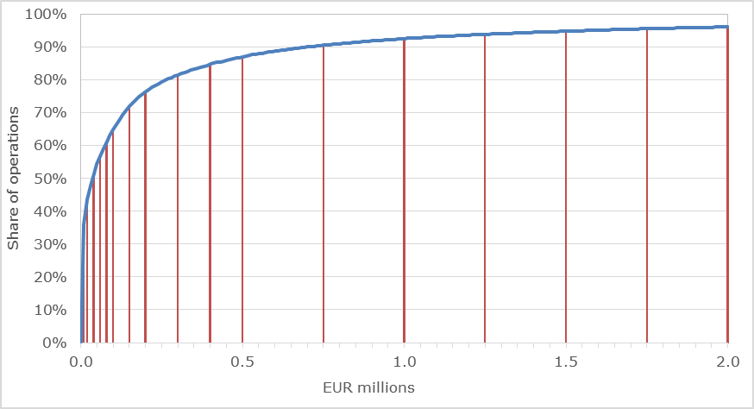
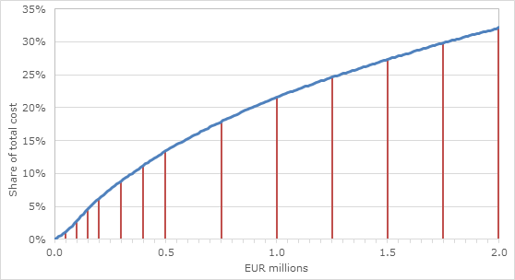
Cumulative estimated distribution of operations by number
Cumulative estimated distribution of operations by total cost

Slide 21
Links to studies on InfoREGIO
http://ec.europa.eu/regional_policy/en/policy/how/improving-investment/studies_integration/

Slide 22
Thank you!

