Slide 1






Slide 2
Measures we use SCOs for
Standard scales of unit costs- Art. 67.1 b) CPR
Lump sums - Art. 67.1 c) CPR
Flat rate financing - Art. 67.1 d) CPR

Slide 3




Standard scales of unit costs - Art. 67.1 b) CPR
Methodology:
Collection of data.
Categorization of costs by Occupational Classifications (SSGS).
Calculation of Standard
scales of unit costs.

Slide 4
Standard scales of unit costs - Art. 67.1 b) CPR
Wage Scale of the Collective Labor Agreements selected
Base salary/category
(average)
Salary bonus
and holidays
Gross Salary
Gross Salary
Company social security payments
Annual
Gross Costs
Art. 68.2 CPR
Latest documented annual gross costs
1720 hours
Unit cost
per hour

Slide 5

Standard scales of unit costs - Art. 67.1 b) CPR
Difficulties:
Latest documented annual gross employment costs implies having a past reference period of one year.
Grouping of Occupational Classifications of the Collective Labor Agreements.
Solutions:
Use of Collective Labor Agreements.
Use of Occupational Classifications of SSGS as a reference.

Slide 6


Standard scales of unit costs - Art. 67.1 b) CPR
Methodology:
Specify the investments.
Define the essential elements.
Collection of data.
Calculation of Standard
scales of unit costs.

Slide 7
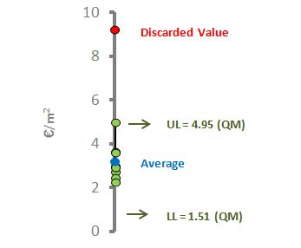
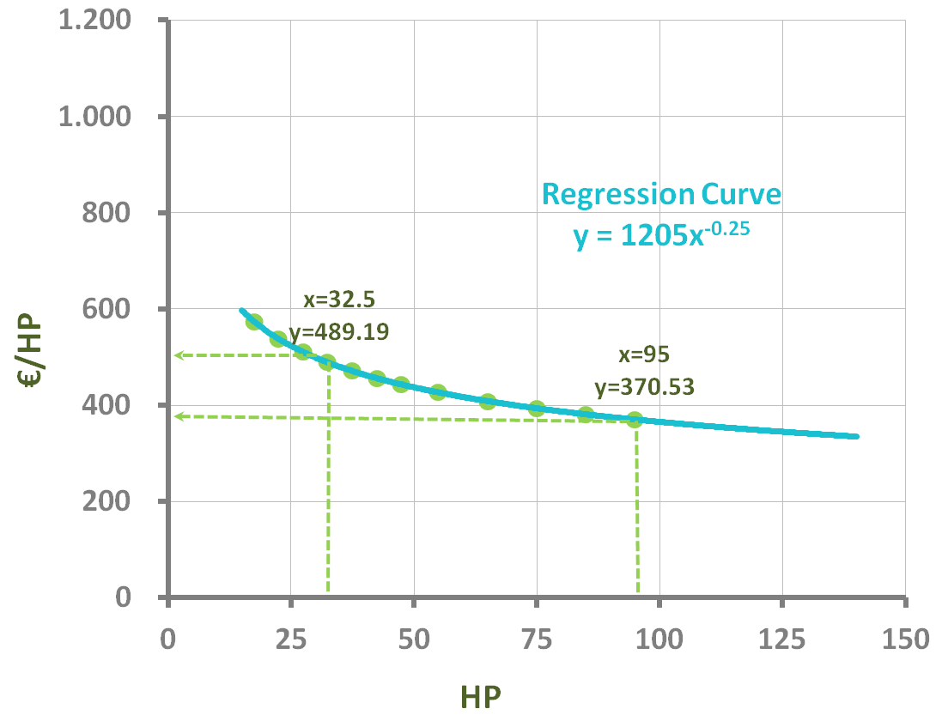
Standard scales of unit costs - Art. 67.1 b) CPR
When the cost does not depend on the magnitude of the investment
When the cost does depend on the magnitude of the investment
Arithmetic mean
Regression curve

Slide 8
Standard scales of unit costs - Art. 67.1 b) CPR
Difficulties:
Its application implies significant previous investments (resources, money, time).
The definition of the type of investment is particularly challenging.
Lack of cooperation from sector suppliers.
New investments arise due to requests from beneficiaries.
Solutions:
Use enough resources supporting the use of SCOs.
Resort to invoices from previous calls and specialist external agents.
Updating with the inclusion of new investments.

Slide 9


Lump sums - Art. 67.1 c) CPR
Methodology:
Analysis of information required.
Categorization of eligible expenditure.
Classification of expense within each category by level.
Collection of data.
Calculation of Lump sums.

Slide 10

Lump sums - Art. 67.1 c) CPR
1
Promotional material
Classification of
eligible costs
Leaflets
Posters
Roll-Ups
Quotations from suppliers
Average for
cost type
Sum of averages
Lump sum by level

Slide 11
Lump sums - Art. 67.1 c) CPR
Difficulties:
Classification of eligible costs by level close to reality.
Escape from a too “Binary approach” (0% or 100% of the grant).
Solutions:
Resort to the analysis of animation costs of Leader and other projects within this area.
Set payout levels.

Slide 12

Flat rate financing - Art. 67.1 d) CPR
Methodology:
Definition of indirect costs.
Classification of indirect costs.
Calculation of Flat rate
financing.

Slide 13

Flat rate financing - Art. 67.1 d) CPR
Calculation of the indirect cost
Total Staff Costs
Unit staff
cost / hour
Registered hours
15
Art. 68.1 b) CPR
Flat rate financing

Slide 14
Flat rate financing - Art. 67.1 d) CPR
Difficulties:
Definition of indirect costs which comply with the premises included in the regulations.
The percentage applied should cover the real indirect costs.
Solutions:
Analysis of previous calls and consultation with auditors on the classification of indirect costs and the percentage applied.

Slide 15

Lessons learned
Start with the implementation of SCOs at an early stage.
Application of SCOs involves taking on significant challenges.
Despite having a legal framework, there is legal uncertainty.
Use of IT tools in the management of SCOs.

Slide 16
Thank you for your attention
Carla Álvarez de Vera (carlaav@gmrcanarias.com)
Regional Ministry of Agriculture, Livestock, Fisheries and Water of the Canary Islands Government

