Slide 1
On the third call
Charo Camacho
Policy Officer| Interreg Europe
c.camacho@interregeurope.eu
23 February 2017NID Prague

Slide 2
Summary
Terms of reference
Reminder on the assessment
Lessons learnt from previous calls
Conclusions

Slide 3
Terms of reference

Slide 4
Terms of reference: main features
Opening: 1 March 2017 (online system open)
Closing: 30 June 2017 (12 pm Paris time)
Early 2018 – expected start of projects
No thematic restrictions
Projects under priority axis 4 are welcome!

Slide 5
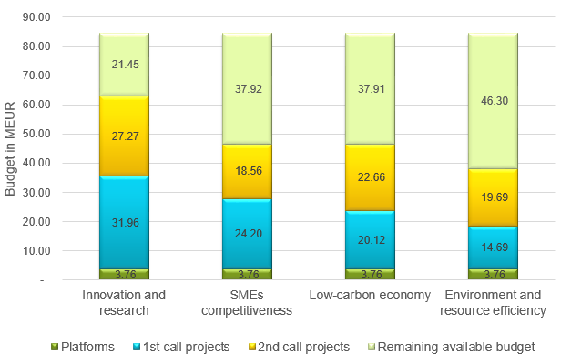
Terms of reference: main features
Budget available:
All remaining ERDF per priority axis available

Slide 6
Terms of reference: recommendations
Innovative character in particular in relation to already successful topics
Topics under represented: financial instruments, renewable energy or water management
Priority axis 4 Environment & Resource Efficiency is slightly lagging behind. Applications are therefore particularly encouraged under this priority axis.
Involvement of regions not already represented encouraged (annex 1 of the terms of reference)

Slide 7
Reminder On assessment

Slide 8
Selection procedure
2-step procedure
I. Eligibility assessment
fulfilment of technical requirements
II. Quality assessment
2-step qualitative evaluation
Detailed description in the programme manual (§5.3)

Slide 9
Eligibility principles
Technical yes or no process
No correction possible
Only eligible applications are further assessed

Slide 10
Eligibility checklist
Is your application complete (partner declarations, support letters)?
Is the application filled in according to instructions?
Is it in English?
Are all partner declarations:
Signed and dated
With name of partner identical to application form
With stated amount covering at least the amount of partner contribution
With no amendments to the standard text

Slide 11
Eligibility checklist
Are all support letters:
Attached to the application form
Signed and dated by relevant organisation (check the country-specific list!!)
With name of partner(s) identical to application form
With no amendments to the standard text
Are at least 3 countries of which 2 are EU members involved and financed by Interreg Europe?
Are at least half of the policy instruments addressed Structural Funds programmes?

Slide 12
Quality assessment
Second step only for eligible applications!
2-step approach
Operational assessment
C 4: Coherence of proposal & quality of approach
C 5: Communication & Management
C 6: Budget and finance
Strategic Assessment
C1: Relevance of proposal
C 2: Quality of results
C 3: Quality of partnership
Only if adequate (≥3.00) proposals are further assessed (Scoring system 0 - 5)
Decision by monitoring committee.
Only projects reaching at least an overall adequate level (≥3.00) are recommended for approval (with conditions) to the monitoring committee.

Slide 13
Assessment provisional timing
July – August 2017 | Eligibility check
September – November 2017 | Quality assessment
End 2017 | Decision & notification
Early 2018 | Fulfilment of conditions
Early 2018 | Effective start date of projects

Slide 14
Lessons learnt

Slide 15
Eligibility
One NO disqualifies whole project no assessment!
High rate of ineligibility (29.4%)
Main causes of ineligibility:
Letters of support (missing or incorrect)
Partner declaration (incorrect – amount lower than necessary!)
Make sure all documents are provided and correct.
Don’t prepare them at the last minute!

Slide 16
Eligibility
Lessons learnt integrated in the third call application pack:
1/ Improved instructions in the application pack:
Warning messages included in different documents
2/ Full online application
Compulsory documents to be uploaded on iOLF

Slide 17
Quality: common weaknesses
Topic addressed (Criterion 1):
Not in line with priority axis
Too broad scope / poorly described
Not reflected in all the policy instruments addressed
Check approved projects at: http://www.interregeurope.eu/discover-projects/

Slide 18
Quality: common weaknesses
Policy instruments (Criterion 1):
Not precisely defined in the AF (e.g. indication of the specific priority addressed)
Misunderstanding for Structural Funds (instrument indicated not the Operational / Cooperation programme)
Check country-specific pages for list of policy-relevant bodies for Structural Funds programmes at:
http://www.interregeurope.eu/in-my-country/

Slide 19
Quality: common weaknesses
Policy relevance of partners (Criterion 3):
No direct involvement of bodies responsible for the policy instrument addressed
No clear policy relevance of the partners involved: involvement in the policy-making process & capacity to influence the policy instrument
Letter of support is not sufficient
Core elements of the quality of partnership: dedicated questions in section B.2 of the application form

Slide 20
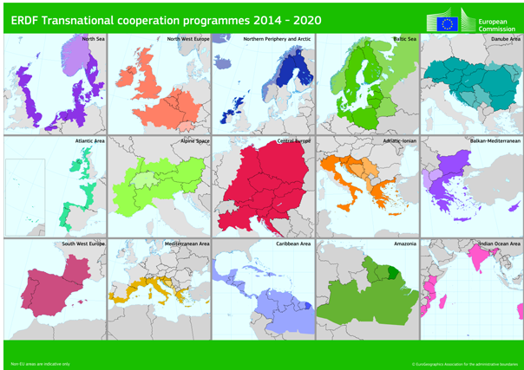
Quality: common weaknesses
Geographical features (Criterion 3)
Coverage limited to a transnational area
Go beyond transnational area!

Slide 21
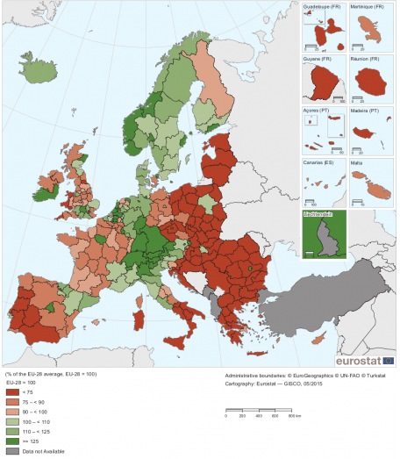
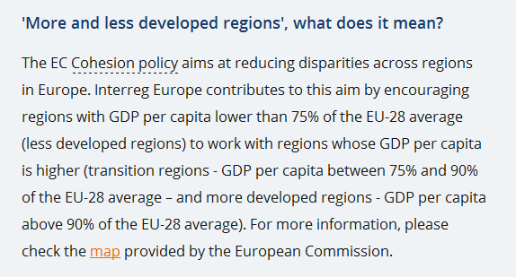
Quality: clarification
Mixing more and less developed regions (GDP) (Criterion 3):
Mix more and less developed regions (GDP)

Slide 22
Quality: justification
Multiple involvement (Criterion 3):
Involvement in numerous applications very demanding and not recommended. Multiple involvement should be justified.
Be strategic: select only the most relevant project(s) for your region

Slide 23
conclusion

Slide 24
Importance of the application form
Fairness and equal treatment principles
Application Form = the only basis for assessment
same information requested from all
same technical requirements for all (e.g. text limits)
Application form has to be self-explanatory
Additional information / clarification not possible after submission

Slide 25
In the application form
A. Project Summary
B.1. Partners
B.2. Policy Instruments (definition and context, territorial context, partner relevance, stakeholders)
C1 – C5. Project Description (story, issue addressed, objectives, approach, communication strategy)
C6. Expected results and outputs (overview of outputs and results, indicators, innovative character, durability of results)
C7. Horizontal principles
C8. Management
D.1. Phase 1 (per semester)
D.2. Phase 2
E. Project Budget
Workplan

Slide 27
Useful links
Programme manual
www.interregeurope.eu/help/programme-manual/
Application pack
www.interregeurope.eu/projects/apply-for-funding/
Online application/ reporting system
www.iolf.eu/
Interreg Europe community
www.interregeurope.eu/account/dashboard/
Project development videos
http://www.interregeurope.eu/projects/project-development/

Slide 28
Thank you!
Questions welcome

