Slide 1
February 2019
Call 4 in a nutshell
Interreg CENTRAL EUROPE, Ministry of Regional Development (CZ), Stella Horvathova

Slide 2
Interreg CENTRAL EUROPE programme features
Builds on transnational cooperation bringing together people from 9 central European countries
Its projects improve capacities of public authorities and practitioners to make their cities and regions stronger
Helps regions and cities to better cope with challenges → from the reduction of heat in cities, cleaner air and water to the prevention of future floods
Call objective
What should the programme achieve with the fourth call?
Projects funded within the fourth call should take up and capitalise existing CE project results at the territorial (downstream) and policy (upstream) levels

Slide 3
We want to take our project results forward
Project partnerships should exploit promising project outputs and results of already funded Interreg CENTRAL EUROPE projects.
The new partnerships should roll out outputs and results at the regional and local level, or use them to improve policy making.
Project ideas have to build on complementary results and outputs from at least 3 different projects that are co-financed by Interreg CENTRAL EUROPE and directly-managed EU programmes such as FP7/Horizon 2020, LIFE, Connecting Europe Facility, etc. At least two of the three projects have to be from Interreg CENTRAL EUROPE.

Slide 4
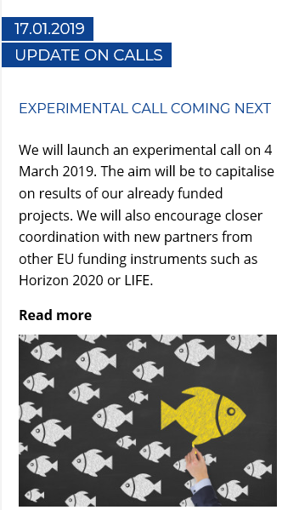
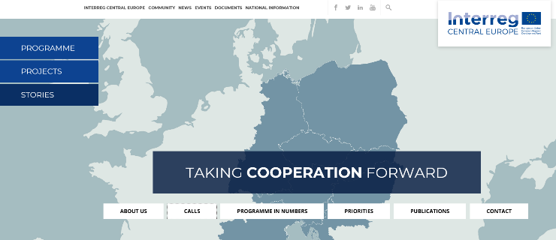
We open the call
from 4 March to 5 July 2019

Slide 5
We aim at capitalisation through coordination
We are looking for a mix of Interreg CENTRAL EUROPE stakeholders and newcomers from projects funded under directly-managed EU programmes.
We believe that cooperation beyond our Interreg community will be central to make results of our currently funded Interreg CENTRAL EUROPE projects even more effective. Additional partners from other Interreg projects, projects funded by mainstreaming programmes as well as complete newcomers are welcome.
The application manual with examples of potential project ideas will be published when the call launches on 4 March.

Slide 6
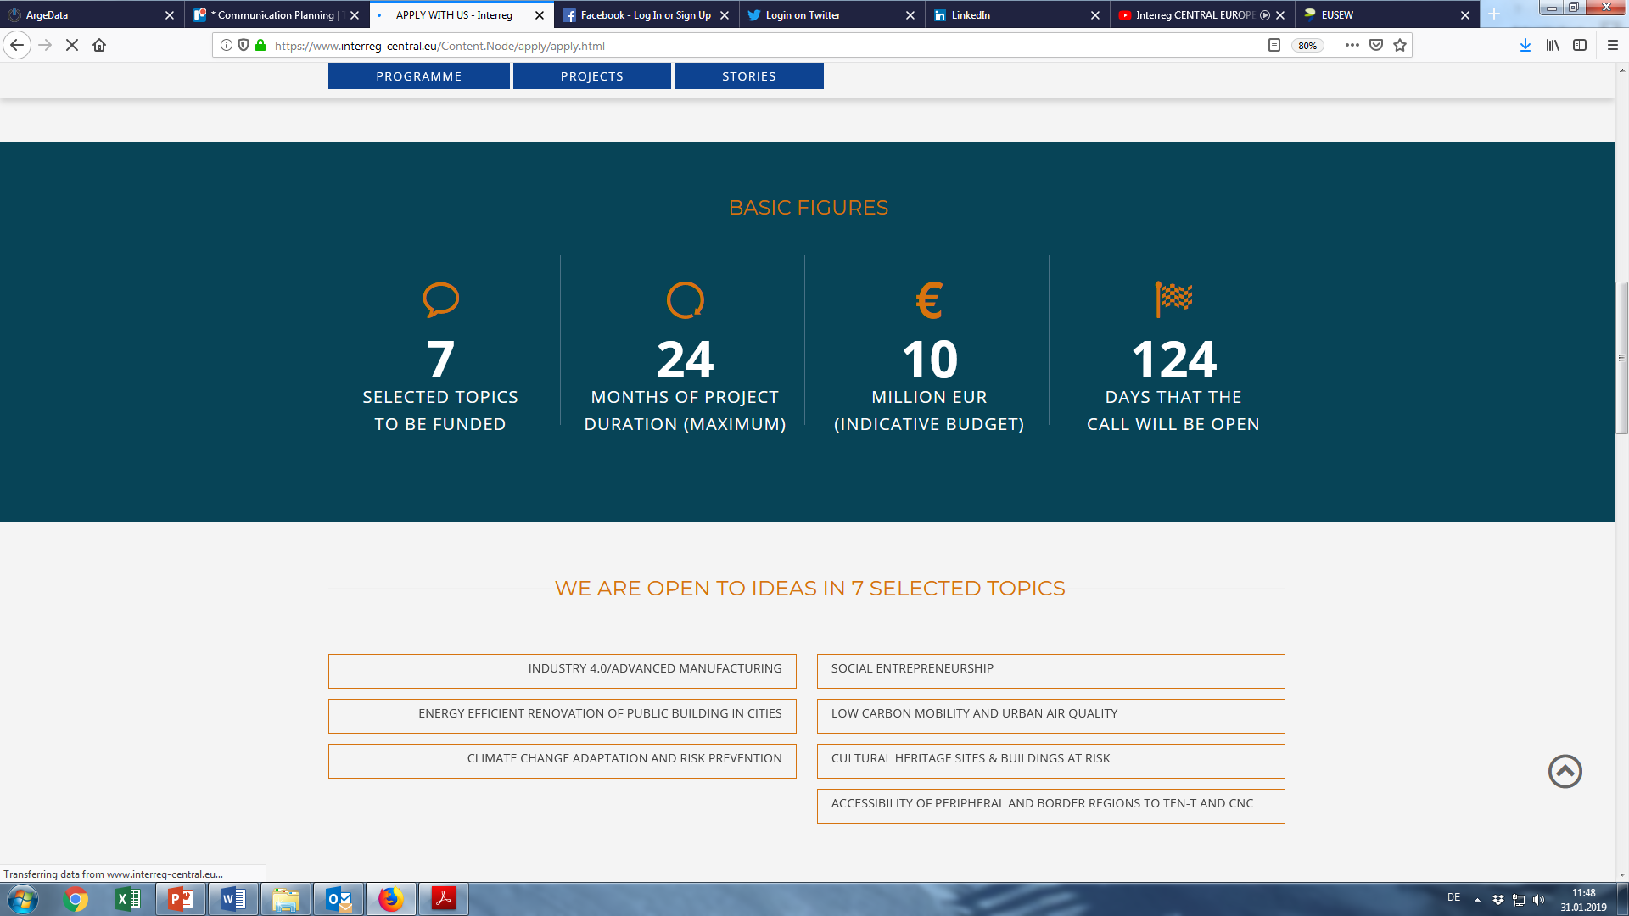
4th call framework

Slide 7
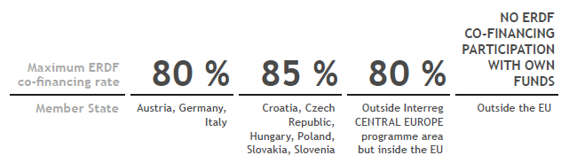
4th call framework
Partners of the Interreg CE projects (belonging to 7 topics) to be exploited
ERDF co-financing rate
Call timeline → project selection within the year
Project start: early 2020
Project duration → depending on the shape of the call, however latest project end is 30.06.2022
Rules: Application manual
€

Slide 8
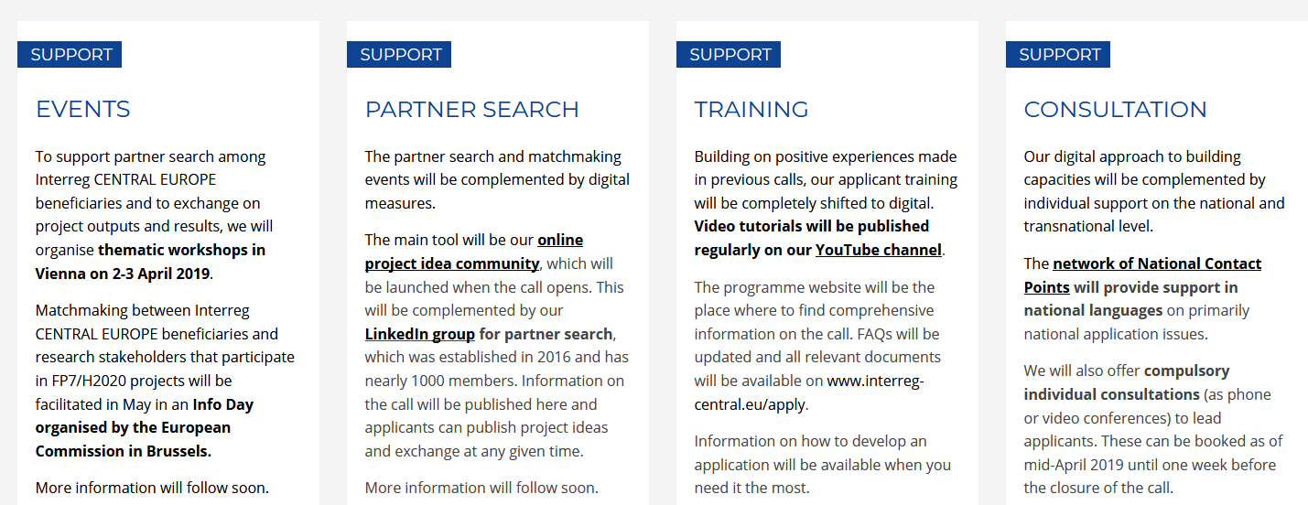
We offer support on various levels

Slide 9
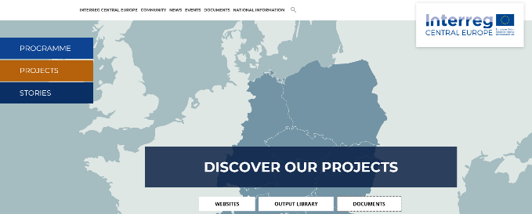
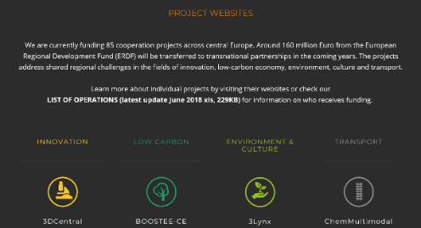
Website / PROJECTS
Xls. chart *LIST OF OPERATIONS available* includes the basic description of projects and project partners involved in Call 1 and Call 2
PROJECT WEBSITES listed
according to 4 PRIORITIES

Slide 10

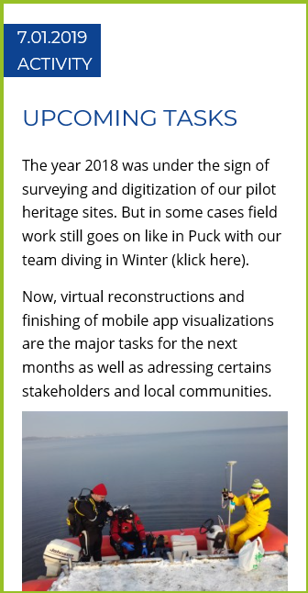

Projects info
STORIES
www.interreg-central.eu/cooperationiscentral
PROJECTS
Events, News,
pilot activities, studies,
partners, contacts,…

Slide 11
CZ National CONTACT point
Ministry of Regional Development, ETC department
office: Letenská 3, Praha
+42 (0) 224 862 213, +42 (0) 224 862 260
nadnarodni@mmr.cz
www.dotaceEU.cz/ Programové období 2014-2020 / Programy
twitter.com/Interreg_CZ @Interreg_CZ
www.interreg-central.eu #cooperationiscentral
facebook.com/InterregCE twitter.com/InterregCE
Linkedin.com/in/interregce
youtube.com/interregcentraleurope

