Slide 1
DTP National InfoDay
27th November 2018, Prague

Slide 2
Agenda
DTP in a nutshell
3rd CfP main elements
Topics tackled by the 3rd CfP
Intervention Logic
Key- factors for successful project application
Project assessment
Eligibility Rules
National Specifics

Slide 3
3. Topics tackled by the 3rd CfP
Innovative and socially responsible Danube Region
Environment and culture responsible Danube Region
Better connected and energy responsible Danube Region
Well governed Danube Region
Opening of SO 4.1 is subject to approval of the programme budget reallocation by the EC.

Slide 4
3. Topics tackled by the 3rd CfP
SO 1.1: Improve framework conditions for innovation
Improve the institutional and infrastructural framework conditions and policy instruments for research & innovation to ensure a broader access to knowledge for the development of new technologies and the social dimension of innovation.

Slide 5
3. Topics tackled by the 3rd CfP
S.O. 1.1 - 3rd Call restrictions!!!
Service innovation, with a focus on strengthening employment via innovative public policies (national or regional authorities should take the lead), and creative industries (with a strong accent on innovative urban regeneration via service hubs)

Slide 6
3. Topics tackled by the 3rd CfP
SO 1.2: Increase competences for business and social innovation
Foster innovative learning systems to increase competences of employees in the business sector, to strengthen entrepreneurial culture and learning contributing to better meet social needs and the delivery of services in the general interest.

Slide 7
3. Topics tackled by the 3rd CfP
S.O. 1.2 - 3rd Call restrictions!!!
Strengthening the capacity of the so-called support organisations (e.g. employment agencies, trade unions, labour market organisations) to provide innovative entrepreneurial training and education to individuals in the framework of the knowledge-based economy. Developing innovative social services able to better meet social needs and to provide services in general interest.

Slide 8
Project Officer PA1 Marius Niculae marius.niculae@interreg-danube.eu +36 1 896 1967
Contact details PA1

Slide 9
3. Topics tackled by the 3rd CfP
SO 2.1: Strengthen transnational water management and flood risk prevention
Strengthen joint and integrated approaches to further develop and implement River Basin Management Plans in the Partner States in line with the overall Danube River Basin Management Plan in order to improve transnational water management and flood risk prevention contributing to the sustainable provision of ecosystem services.

Slide 10
3. Topics tackled by the 3rd CfP
S.O. 2.1 - 3rd Call restrictions!!!
Water quality management, e.g. integrated policies, strategies, solutions, measures to reduce nutrient and hazardous substance pollution, improving quality of (surface and ground) waters in the Danube and its transnationally relevant (sub-)River Basin(s) - monitoring is not expected to be in the main focus of such projects More efficient waste water treatment solutions that can prove transnational impact; Integrated ground water resources management (from quality and / or quantity aspect), in case the transnational relevance and approach can reasonably be proved by a project. Managing water resources from quantitative aspects (balanced usage, inter-sectorial coordination and cooperation) having transnational impact on water bodies. Strategic approach in harmonised and coordinated operative flood prevention measures (e.g. inter-sectorial coordination, including hydropower, navigation, etc.) for transnationally relevant river (basins) - monitoring is not expected to be in the main focus of such projects

Slide 11
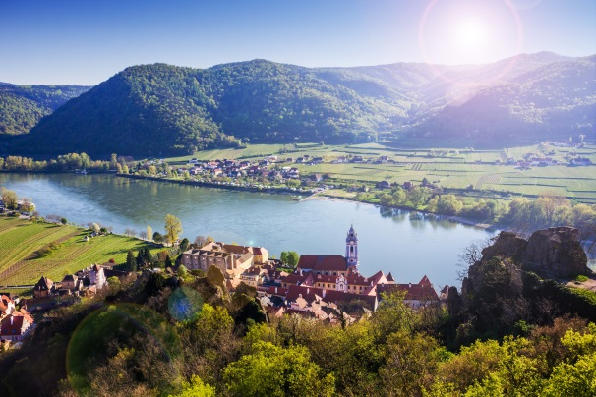
3. Topics tackled by the 3rd CfP
SO 2.2: Foster sustainable use of natural and cultural heritage and resources
Strengthen joint and integrated approaches to preserve and manage the diversity of natural and cultural heritage and resources in the Danube region as a basis for sustainable development and growth strategies.
No restrictions for the 3rd Call!

Slide 12
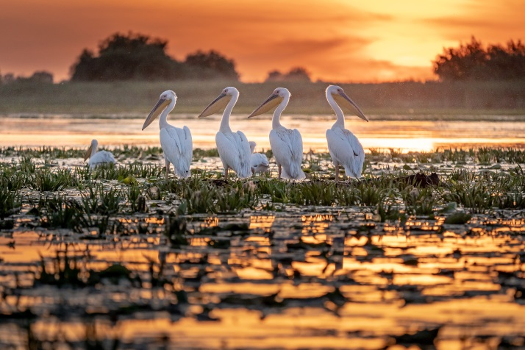
3. Topics tackled by the 3rd CfP
SO 2.3: Foster the restoration and management of ecological corridors
Strengthen effective approaches to preservation, restoring and management of bio-corridors and wetlands of transnational relevance to contribute to the better conservation status of ecosystems of European relevance.
No restrictions for the 3rd Call!

Slide 13
3. Topics tackled by the 3rd CfP
SO 2.4: Improve preparedness for environmental risk management
Establish and develop a more effective governance system for environmental protection addressing emergency situations and improve the preparedness of public authorities and civil protection organisation contributing to the reduction of risks and impact on ecosystem services, biodiversity and human health.
No restrictions for the 3rd Call!

Slide 14
Project Officers PA2 Simona Ene (SO 2.2) simona.ene@interreg-danube.eu +36 1 795 4082 Gusztav Csomor (SO 2.1, 2.3, 2.4) gusztav.csomor@interreg-danube.eu +36 1 795 3836
Contact details PA2

Slide 15
3. Topics tackled by the 3rd CfP
SO 3.1: Support environmentally-friendly and safe transport systems and balanced accessibility of urban and rural areas
Improve planning, coordination and creating practical solutions for an environmentally-friendly, low-carbon and safer transport network and services in the programme area contributing to a balanced accessibility of urban and rural areas.

Slide 16
3. Topics tackled by the 3rd CfP
S.O. 3.1. - 3rd Call restrictions!!!
Transport corridors crossing the Danube region (e.g. addressing identified missing links, proposing solutions for improvement including [cross-border] traffic management systems, developing actions plans/ feasibility plans aimed at further developing the transport corridors – considering the pre-identified projects or their development status), Cycling routes crossing the Danube region (e.g. identifying missing links, proposing solutions for improvement, developing actions plans/ feasibility plans aimed at further developing the routes) Inter- and multi-modality, including development of ports’ connections to road and rail transport for the improvement of transport chains

Slide 17
3. Topics tackled by the 3rd CfP
So 3.2 Improve energy security and energy efficiency
Contribute to the energy security and energy efficiency of the region BY supporting the development of joint regional storage and distribution solutions and strategies for increasing energy efficiency and renewable energy usage.
No restrictions for the 3rdCall!

Slide 18
Project Officer PA3 Ana Leganel ana.leganel@interreg-danube.eu +36 1 795 5338
Contact details PA3

Slide 19
3. Topics tackled by the 3rd CfP
SO 4.1: Improve institutional capacities to tackle major societal challenges
*Opening is subject to approval of the programme budget reallocation by the EC.
Strengthen multi-level and transnational governance and institutional capacities and provide viable institutional and legal frameworks for more effective, wider and deeper transnational cooperation across the Danube region in areas with major societal challenges.
No restrictions for the 3rdCall!

Slide 20
3. Topics tackled by the 3rd CfP
SO 4.1: Improve institutional capacities to tackle major societal challenges
No restrictions under this S.O. but certain topics highlighted for ensuring strategic impact and avoiding duplications:
Education: Stronger focus on increasing the educational attainment, recognition of skill-level across borders and provision of educational services for vulnerable / marginalised groups
Migration: stronger focus on labour market implication, inclusive approaches regarding specific target groups (e.g. woman, low skilled) and service provision (e.g. health care or housing);
Labour market policies: stronger focus on youth and access to quality employment for specific target groups (e.g. youth, elderly, woman, vulnerable groups).
Active citizenship and sustainable democracy

Slide 21
Project Officer PA4 Johannes Gabriel johannes.gabriel@interreg-danube.eu +36 1 795 5886
Contact details PA4

Slide 22
4. Intervention Logic
Intervention Logic
DTP core principle → result-orientation, the basis for this approach being the change
Intervention logic → a tool showing how the change will be achieved that defines:
Status quo
The change
The specific objectives
The actions, outputs, stakeholders and target groups
The results and durability

Slide 23
4. Intervention Logic
Programme
Project
Programme Mission
Specific Objective X
[ … ]
Project Main Objective
Contribution to Programme Specific Objective
Project Specific Objectives
Contribution to Project Main Objective
Targets
(semi-quantitative)
Result (Indicator)
Intensity of cooperation of key actors and stakeholders in the Danube area …
Project Result
Contribution to Programme Result Indicator
Targets
(quantitative)
Output (Indicators)
Nr. of strategies
Nr. of tools
Nr. of pilot actions
Nr. of documented learning interactions
Project Outputs
Contribution to Programme Output Indicators
WORK PLAN

Slide 24
4. Intervention Logic
Project Intervention Logic - Objectives
Specific Objective X
[ … ]
Project Main Objective
What is the intended strategic, long-term change?
Definition of only one concise main objective
Description of the contribution of the main objective to the Programme Specific Objective
Project Specific Objectives
What are the immediate effects of the project?
Definition of up to three concrete sub-objectives
Description of the contribution of the specific objectives to the project main objective

Slide 25
4. Intervention Logic
Project Intervention Logic – Result
Programme
Result Indicator
Intensity of cooperation of key actors and stakeholders in the Danube area …
Project Result
What is the benefit of using the project outputs?
Description of one concise result only
Description of the contribution of the project result to the Programme Result Indicator

Slide 26
4. Intervention Logic
Project Intervention Logic - Outputs
Programme
Output Indicators
Nr. of strategies
Nr. of tools
Nr. of pilot actions
Nr. of documented learning interactions
Project Outputs
What has been produced for the money given?
Project outputs have to contribute to one compulsory programme output indicator (documented learning interactions)
… and have to contribute to one up to max. 4 further programme output indicator

Slide 27
4. Intervention Logic
Intervention Logic – Outputs
Project Outputs
Programme
Output Indicators
Nr. of strategies
Nr. of tools
Nr. of pilot actions
Nr. of documented learning interactions
Output | Value
1 Danubian strategy for (…) based on 8 country reports | 1
1 Danubian strategy for (…) based on 8 country reports | 8
4 local action plans (for 4 pilots) | 4
1 E-learning platform | 1
1 internal project management manual | 1
Pilot implementation of action plans in 4 sites | 4
Implementation 1 E-learning course (4 X 25 particip.) | 1
Implementation 1 E-learning course (4 X 25 particip.) | 4
Implementation 1 E-learning course (4 X 25 particip.) | 100

Slide 28
5. Key factors for successful project application
Start with…
… the project idea…
Look for the most appropriate partners…
Develop the intervention logic…
Develop the workplan…

Slide 29
5. Key factors for successful project application
What to consider when applying?
Thematic scope clearly in line with one S.O.
Transnational dimension and territorial relevance
Composition of the partnership
Contribution to the EUSDR
Realistic and consistent workplan
Balanced budget / value for money

Slide 30
5. Key factors for successful project application
Do we have a vision regarding a concrete territorial change in the Danube Region?
Do we address Danube-specific needs (potentials) with our project idea?
Is the project idea clearly, explicitly and authentically addressing one of the SO of the DTP (taking into account thematic restrictions under the 3rd CfP)?
Partners we have (in mind): critical mass, commitment and competence ensured?
Synergies with EUSDR considered?
Intervention logic: is it really in line with DTP requirements and consistent?
Did we critically self-assess all crucial dimensions of the proposal?
Did we double-check with the JS PO and/or an NCP and/or an “outsider”?

Slide 31
Supportive info and actions
Information
Interaction with
Applicants Manual Manual
JS
NCP
Guidelines for EoI
Factsheets per S.O.
Concept Note
INTERREG Community (CZ and beyond)
Thematic Seminar

Slide 32
6. Assessment
General Framework
EoI
Eligibility 6 yes/no questions | Quality 5 questions
AF
Eligibility 13 yes/no questions | Quality
 | Strategic assessment 6 main questions + sub-questions Threshold 60%
 | Operational assessment 5 main questions + sub-questions
Overall threshold is 60%!

Slide 33
6. Assessment
EoI eligibility assessment
No. | Eligibility criteria | Description
1 | The EoI has been submitted within the set deadline (date and time) | The EoI has been submitted within the date and time set in the call announcement.
2 | The EoI has been submitted through the eMS | The EoI has been submitted through eMS monitoring system of the programme.
3 | The EoI is compiled in English | All parts of the EoI are compiled in English, as the official language of the DTP.
4 | Partnership is composed by at least three financing partners from at least three participating countries of which at least one is located in a Member State | Partnership complies with the minimum requirement for a transnational DTP partnership: at least three financing partners (receiving ERDF, IPA or ENI co-financing) from at least three participating countries, of which at least one, the LP, is located in a Member State.
5 | Lead Applicants is an eligible beneficiary | The Lead Applicant fulfils the requirement set in Part 2, section II of this manual.
6 | The proposal has selected at least two programme output indicators in connection to the outputs defined by the applicant | The proposal has selected the horizontal output indicator and at least another programme output indicator in connection to the outputs defined by the applicant.

Slide 34
6. Assessment
EoI quality assessment
1. Is the proposal in line with the focus of the programme and call?
Project topic - in line with the SO and Call provisions
Project - is NOT investment or research oriented and it does not target mere networking
Project - is NOT a duplication of previously funded actions

Slide 35
6. Assessment
EoI quality assessment
2. Is the project intervention logic coherent and in line with the programme one?
Coherent link between the project main objective, outputs and result and the Programme intervention logic
Project contributes to the achievement of the specific objective and results of the relevant DTP priority

Slide 36
6. Assessment
EoI quality assessment
3. Does the project have clear transnational dimension and impact?
Project arises from a common need and it does not represent a collection of local actions
Project activities have a transnational dimension and the project outputs have a transnational impact

Slide 37
6. Assessment
EoI quality assessment
4. Is the partnership composition relevant, justified and balanced for the proposed project?
Partnership is appropriate in terms of geographical coverage and competences in relation to the project topic
Distribution of tasks among the partners is equitable and it contributes to the achievement of the project objective

Slide 38
6. Assessment
EoI quality assessment
5. Is the budget coherent with the planned activities and involved partners?
Overall value of the proposal
Distribution of budget per WP and PP in accordance with planned activities and involvement of the PPs

Slide 39
6. Assessment
AF eligibility assessment
No. | Eligibility criteria | Description
1 | The AF has been submitted within the set deadline (date and time) | The AF has been submitted within the date and time set in the call announcement.
2 | The AF has been submitted through the eMS monitoring system | The AF has been submitted through the official eMS monitoring system.
3 | The AF is compiled in English | All parts of the AF are compiled in English, as the official language of the DTP.
4 | Partnership is composed by at least three financing partners from at least three participating countries of which at least one (LP) is located in a Member State | Partnership complies with the minimum requirement for a transnational DTP partnership: at least three financing partners (receiving ERDF, IPA or ENI co-financing) from at least three participating countries, of which at least one (LP) is located in a Member State.
5 | Lead Applicant is an eligible beneficiary | The Lead Applicant fulfils the requirement set in Part 2, section II of the Applicants Manual.
6 | At least 3 joint cooperation levels are indicated | According to Art 12(4) of EU reg. 1299/2013, among the four levels of cooperation (joint development, joint implementation, joint staffing and joint financing) beneficiaries shall cooperate in the development and implementation of projects and in either the staffing or the financing of projects, or in both.

Slide 40
6. Assessment
AF eligibility assessment
No. | Eligibility criteria | Description
7 | The main characteristics of the project intervention logic in the AF have not been modified compared to the one outlined in the EoI | The scope of the project main objective, specific objectives, result, outputs as outlined in the EoI are not modified in the AF.
8 | The Lead Partner in the AF has not been changed compared to the one in the EoI | The institution of the Lead Partner in the AF is the same as the one applying in the EoI. Administrative changes are not considered a change under this criterion.
9 | Changes of partners between the EoI and the AF respected the threshold | Changes (replacement and/ or withdrawal) of directly financed partners do not exceed the threshold of maximum 4 partners
10 | Completeness of Partnership Agreement | The Partnership Agreement is complete and signed by all directly financed partners.
Failure to meet any of the above criteria leads to the rejection of the whole project proposal!

Slide 41
Joint Secretariat
www.interreg-danube.eu

